Slide 1
Compression Strategies & Alternate Summarization
Systems and Applications
Ling 573
May 26, 2020

Slide 2
Roadmap
Content Realization: Compression
Rule-, sequence-, tree-based models
Alternate views of summarization
Dimensions of summarization redux
Meeting summarization
Speech summarization

Slide 3
Learning Compression
Cornell (Wang et al, 2013)
Contrasted three main compression strategies
Rule-based
Sequence-based learning
Tree-based, learned models
Resulting sentences selected by SVR model

Slide 4
Rule-Based Approach
Similar to Conroy et al
Removes:
Headers
Relative dates
Attribution
Lead adverbials, adverbial clause modifiers
Appositives, parenthesized elements
Non-restrictive relative clauses

Slide 5
Compression Corpus
(Clark & Lapata, 2008)
Manually created corpus:
Written: 82 newswire articles (BNC, ANT)
Spoken: 50 stories from HUB-5 broadcast news

Slide 6
Compression Corpus
(Clark & Lapata, 2008)
Manually created corpus:
Written: 82 newswire articles (BNC, ANT)
Spoken: 50 stories from HUB-5 broadcast news
Annotators created compression sentence by sentence
Could mark as not compressable

Slide 7
Sequence-based Compression
View as sequence labeling problem

Slide 8
Sequence-based Compression
View as sequence labeling problem
Decision for each word in sentence: keep vs delete

Slide 9
Sequence-based Compression
View as sequence labeling problem
Decision for each word in sentence: keep vs delete
Model: linear-chain CRF
Labels: B-retain, I-retain, O (token to be removed)

Slide 10
Sequence-based Compression
View as sequence labeling problem
Decision for each word in sentence: keep vs delete
Model: linear-chain CRF
Labels: B-retain, I-retain, O (token to be removed)
Features:
“Basic” features: word-based
Rule-based features: if fire, force to O
Dependency tree features: Relations, depth
Syntactic tree features: POS, labels, head, chunk
Semantic features: predicate, SRL
Include features for neighbors

Slide 11
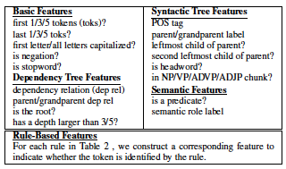
Feature Set
Detail:

Slide 12
Tree-based Compression
Given a phrase-structure parse tree,
Determine if each node is: removed, retained, or partial

Slide 13
Tree-based Compression
Given a phrase-structure parse tree,
Determine if each node is: removed, retained, or partial
Issues:
# possible compressions exponential

Slide 14
Tree-based Compression
Given a phrase-structure parse tree,
Determine if each node is: removed, retained, or partial
Issues:
# possible compressions exponential
Need some local way of scoring a node

Slide 15
Tree-based Compression
Given a phrase-structure parse tree,
Determine if each node is: removed, retained, or partial
Issues:
# possible compressions exponential
Need some local way of scoring a node
Need some way of ensuring consistency

Slide 16
Tree-based Compression
Given a phrase-structure parse tree,
Determine if each node is: removed, retained, or partial
Issues:
# possible compressions exponential
Need some local way of scoring a node
Need some way of ensuring consistency
Need to ensure grammaticality

Slide 17
Tree-based Compression
Given a phrase-structure parse tree,
Determine if each node is: removed, retained, or partial
Issues & Solutions:
# possible compressions exponential
Order parse tree nodes (here post-order)
Do beam search over candidate labelings

Slide 18
Tree-based Compression
Given a phrase-structure parse tree,
Determine if each node is: removed, retained, or partial
Issues & Solutions:
# possible compressions exponential
Order parse tree nodes (here post-order)
Do beam search over candidate labelings
Need some local way of scoring a node

Slide 19
Tree-based Compression
Given a phrase-structure parse tree,
Determine if each node is: removed, retained, or partial
Issues & Solutions:
# possible compressions exponential
Order parse tree nodes (here post-order)
Do beam search over candidate labelings
Need some local way of scoring a node
Use MaxEnt to compute probability of label
Need some way of ensuring consistency

Slide 20
Tree-based Compression
Given a phrase-structure parse tree,
Determine if each node is: removed, retained, or partial
Issues & Solutions:
# possible compressions exponential
Order parse tree nodes (here post-order)
Do beam search over candidate labelings
Need some local way of scoring a node
Use MaxEnt to compute probability of label
Need some way of ensuring consistency
Restrict candidate labels based on context
Need to ensure grammaticality

Slide 21
Tree-based Compression
Given a phrase-structure parse tree,
Determine if each node is: removed, retained, or partial
Issues & Solutions:
# possible compressions exponential
Order parse tree nodes (here post-order)
Do beam search over candidate labelings
Need some local way of scoring a node
Use MaxEnt to compute probability of label
Need some way of ensuring consistency
Restrict candidate labels based on context
Need to ensure grammaticality
Rerank resulting sentences using n-gram LM

Slide 22
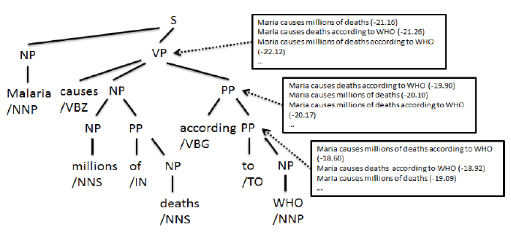
Tree Compression Hypotheses

Slide 23
Features
Basic features:
Analogous to those for sequence labeling

Slide 24
Features
Basic features:
Analogous to those for sequence labeling
Enhancements:
Context features: decisions about child, sibling nodes

Slide 25
Features
Basic features:
Analogous to those for sequence labeling
Enhancements:
Context features: decisions about child, sibling nodes
Head-driven search:
Reorder so head nodes at each level checked first
Why?

Slide 26
Features
Basic features:
Analogous to those for sequence labeling
Enhancements:
Context features: decisions about child, sibling nodes
Head-driven search:
Reorder so head nodes at each level checked first
Why? If head is dropped, shouldn’t keep rest
Revise context features

Slide 27
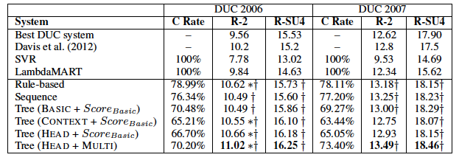
Summarization Results

Slide 28
Discussion
Best system incorporates:
Tree structure
Machine learning
Summarization features

Slide 29
Discussion
Best system incorporates:
Tree structure
Machine learning
Summarization features
Rule-based approach surprisingly competitive
Though less aggressive in terms of compression

Slide 30
Discussion
Best system incorporates:
Tree structure
Machine learning
Summarization features
Rule-based approach surprisingly competitive
Though less aggressive in terms of compression
Learning based approaches enabled by sentence compression corpus

Slide 31
General Discussion
Broad range of approaches:
Informed by similar linguistic constraints
Implemented in different ways:

Slide 32
General Discussion
Broad range of approaches:
Informed by similar linguistic constraints
Implemented in different ways:
Heuristic vs Learned
Surface patterns vs parse trees vs SRL
Even with linguistic constraints
Often negatively impact linguistic quality

Slide 33
General Discussion
Broad range of approaches:
Informed by similar linguistic constraints
Implemented in different ways:
Heuristic vs Learned
Surface patterns vs parse trees vs SRL
Even with linguistic constraints
Often negatively impact linguistic quality
Key issue: errors in linguistic analysis
POS taggers → Parsers → SRL, etc

Slide 34
Alternate Views of Summarization

Slide 35
Dimensions of TAC Summarization
Use purpose: Reflective summaries
Audience: Analysts
Derivation (extactive vs abstractive): Largely extractive
Coverage (generic vs focused): “Guided”
Units (single vs multi): Multi-document
Reduction: 100 words
Input/Output form factors (language, genre, register, form)
English, newswire, paragraph text

Slide 36
Other Types of Summaries

Slide 37
Meeting Summaries
What do you want out of a summary?

Slide 38
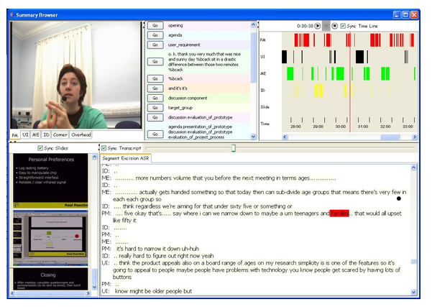
Example
Browser:

Slide 39
Meeting Summaries
What do you want out of a summary?
Minutes?
Agenda-based?
To-do list
Points of (Dis)agreement

Slide 40
Dimensions of Meeting Summaries
Use purpose:
Audience
Derivation (extactive vs abstractive):.
Coverage (generic vs focused):
Units (single vs multi):
Reduction:
Input/Output form factors (language, genre, register, form)

Slide 41
Dimensions of Meeting Summaries
Use purpose: Catch up on missed meetings
Audience: Ordinary attendees
Derivation (extactive vs abstractive): Extractive or Abstr.
Coverage (generic vs focused): User-based?
Units (single vs multi): Single event
Reduction: ?
Input/Output form factors (language, genre, register, form)
English, speech+, lists/bullets/todos

Slide 42
Examples
Decision summary:
1. The remote will resemble the potato prototype
2. There will be no feature to help find the remote when it is misplaced;
instead the remote will be in a bright colour to address this issue.
3. The corporate logo will be on the remote.
4. One of the colours for the remote will contain the corporate colours.
5. The remote will have six buttons.
6. The buttons will all be one colour.
7. The case will be single curve.
8. The case will be made of rubber.
9. The case will have a special colour.

Slide 43
Examples
Action items:
They will receive specific instructions for the next meeting by email.
They will fill out the questionnaire.

Slide 44
Examples
Abstractive summary:
When this functional design meeting opens the project manager tells the group about the project restrictions he received from management by email. The marketing expert is first to present, summarizing user requirements data from a questionnaire given to 100 respondents. The marketing expert explains various user preferences and complaints about remotes as well as different interests among age groups. He prefers that they aim users from ages 16-45, improve the most-used functions, and make a placeholder for the remote…

Slide 45
Speech Summarization

Slide 46
Speech Summary Applications
Why summarize speech?
Meeting summarization

Slide 47
Speech Summary Applications
Why summarize speech?
Meeting summarization
Lecture summarization
Voicemail summarization
Broadcast news
Debates, etc….

Slide 48
Speech and Text Summarization
Commonalities:

Slide 49
Speech and Text Summarization
Commonalities:
Require key content selection
Linguistic cues: lexical, syntactic, discourse structure
Alternative strategies: extractive, abstractive

Slide 50
Speech vs Text
Challenges of speech (summarization):

Slide 51
Speech vs Text
Challenges of speech (summarization):
Recognition (and ASR errors)
Downstream NLP processing issues, errors
Segmentation: speaker, story, sentence
Channel issues (anchor vs remote)
Disfluencies
Overlaps
“Lower information density”: off-talk, chitchat, etc
Generation: text? Speech? Resynthesis?
Other text cues: capitalization, paragraphs, etc
New information

Slide 52
Speech vs Text
Challenges of speech (summarization):
Recognition (and ASR errors)
Downstream NLP processing issues, errors
Segmentation: speaker, story, sentence
Channel issues (anchor vs remote)
Disfluencies
Overlaps
“Lower information density”: off-talk, chitchat, etc
Generation: text? Speech? Resynthesis?
Other text cues: capitalization, paragraphs, etc
New information: audio signal, prosody, dialog structure

Slide 53
Text vs. Speech Summarization (NEWS)
Speech Signal
Speech Channels
- phone, remote satellite, station
Error-free Text
Transcripts
- ASR, Close Captioned
Transcript- Manual
Lexical Features
Many Speakers
- speaking styles
Some Lexical Features
Segmentation
-sentences
Story presentation
style
Structure
-Anchor, Reporter Interaction
Prosodic Features
-pitch, energy, duration
NLP tools
Commercials, Weather Report
Hirschberg, 2006

Slide 54
Current Approaches
Predominantly extractive
Significant focus on compression
Why?

Slide 55
Current Approaches
Predominantly extractive
Significant focus on compression
Why?
Fluency: raw speech is often messy
Speed: speech is (relatively) slow, if using playback
Integration of speech features

Slide 56
Current Data
Speech summary data:
Broadcast news
Lectures
Meetings
Talk shows
Conversations (Switchboard, Callhome)
Voicemail

Slide 57
Common Strategies
Basically, do ASR and treat like text

Slide 58
Common Strategies
Basically, do ASR and treat like text
Unsupervised approaches:
Tf-idf cosine; LSA; MMR

Slide 59
Common Strategies
Basically, do ASR and treat like text
Unsupervised approaches:
Tf-idf cosine; LSA; MMR
Classification-based approaches:
Features include:
Sentence position, sentence length, sentence score/weight
Discourse & local context features
Modeling approaches:
SVMs, logistic regression, CRFs, etc

Slide 60
What about “Speech”?
Automatic sentence segmentation

Slide 61
What about “Speech”?
Automatic sentence segmentation
Disfluency tagging, filtering

Slide 62
What about “Speech”?
Automatic sentence segmentation
Disfluency tagging, filtering
Speaker-related features:

Slide 63
What about “Speech”?
Automatic sentence segmentation
Disfluency tagging, filtering
Speaker-related features:
Speaker role (e.g. anchor), proportion of speech
ASR confidence scores:

Slide 64
What about “Speech”?
Automatic sentence segmentation
Disfluency tagging, filtering
Speaker-related features:
Speaker role (e.g. anchor), proportion of speech
ASR confidence scores:
Intuition: use more reliable content
Prosody:
Pitch, intensity, speaking rate
Can indicate

Slide 65
What about “Speech”?
Automatic sentence segmentation
Disfluency tagging, filtering
Speaker-related features:
Speaker role (e.g. anchor), proportion of speech
ASR confidence scores:
Intuition: use more reliable content
Prosody:
Pitch, intensity, speaking rate
Can indicate: emphasis, new topic, new information

Slide 66
Speech-focused Summarization
Intuition:
How something is said is as important as what is said

Slide 67
Speech-focused Summarization
Intuition:
How something is said is as important as what is said
Hypothesis:
Speakers use pitch, intensity, speaking rate to mark important information

Slide 68
Speech-focused Summarization
Intuition:
How something is said is as important as what is said
Hypothesis:
Speakers use pitch, intensity, speaking rate to mark important information
Test:
Can we do speech summarization without speech transcription?
At least competitively with ASR
Jauhar, Chen, and Metze 2013; Maskey & Hirschberg, ‘05,’06

Slide 69
Approach
Jahaur, Chen, Metze 2013
Data: Multi-party meetings
Segmented into utterances
Goal: Extract most ”noteworthy” utterances
Correspond to reference, annotated by 2 labelers
Approach:
Two-layer random walk model
Prosodic layer: prosodic features
Utterance layer: individual utterances
Edges ONLY between layers
Weights: Values of prosodic feature for utterance

Slide 70
Prosodic Measures
# syllables, # pauses
Total duration, phonation duration
Speaking rate, articulation rate
F0: Mean, max, min
Energy, intensity

Slide 71
Results
Overall:
For short summaries, “Lead” is best
For longer summaries, prosody RW is best
Outperforms measures with word knowledge
Highest weighted prosodic measures:
# pauses, pitch, intensity
Unsupervised prosody-only model !

Slide 72
Approach
Maskey & Hirschberg, 2005, 2006
Data: Broadcast News (e.g. CNN)
Single-document summarization
Has sentence, turn, topic annotation

Slide 73
Summary
Speech summarization:
Builds on text based models
Extends to
Overcome speech-specific challenges
Exploit speech-specific cues
Can be highly domain/task dependent
Highly challenging

